Slide 1

Search Engine Optimisation Strategy for flinkIt
Aryan Kotak

Slide 2
INSTRUCTIONS
Create a website structure
Pick up one blog page & its topic, one product page, one product category page
Create the content structure for these 3 pages
Do detailed keyword research for each page
List down all the important On-page elements of the 3 pages and write them yourself
Do a competitive analysis and tell us the top pages, top ranking keywords for the brand
Write a 300-word paragraph on the blog topic that you've picked up. Use keywords and write the on-page elements for it.

Slide 3
PROBLEM STATEMENT
Flinkit, a hyperlocal grocery delivery platform, aims to provide ultra-fast delivery within 10–15 minutes. However, it faces challenges like maintaining consistent delivery times, managing inventory, and optimizing supply chains to ensure product availability and quality. Additionally, the platform needs to balance operational costs while offering competitive pricing and free/affordable delivery.
To succeed, Flinkit must focus on improving logistics, enhancing customer satisfaction through reliable service, and expanding its user base in a competitive market. Addressing these challenges effectively will help Flinkit establish itself as a leader in the hyperlocal delivery space.
Flinkit also faces the challenge of building trust and loyalty among its customers by ensuring product freshness, timely refunds, and seamless user experiences. In a highly competitive market, creating personalized offers, loyalty programs, and efficient customer support is crucial. By leveraging technology to optimize delivery routes, scale its platform, and ensure real-time inventory updates, Flinkit can enhance its operational efficiency and meet customer expectations while continuing to expand into new markets.

Slide 4
OBJECTIVES
Flinkit aims to provide a seamless and fast delivery experience by ensuring customer satisfaction with quick, accurate, and reliable services. By improving app functionality and offering personalized deals, Flinkit strives to create a smooth and enjoyable shopping journey for its users.
The company is focused on expanding its reach to more cities, targeting key customer groups, and increasing its market presence through strategic marketing efforts and partnerships. This expansion will help Flinkit become a leader in the hyperlocal delivery industry.
Flinkit also prioritizes efficiency and sustainability by optimizing its operations, reducing costs, and adopting eco-friendly practices. With continuous improvements in technology, inventory management, and delivery logistics, Flinkit is committed to creating a sustainable and innovative service for its customers.

Slide 5
APPROACH
Flinkit focuses on providing a customer-first approach, prioritizing speed, reliability, and convenience in every order. By leveraging advanced technology, the company continuously improves its app and backend systems to ensure a seamless experience, reducing delivery times and enhancing user satisfaction. Personalized promotions and easy navigation create a tailored shopping experience for users, fostering long-term loyalty.
Expansion is a key focus, and Flinkit strategically targets new cities while focusing on localized marketing efforts to cater to specific customer needs. Collaborating with local suppliers and retailers ensures a diverse range of products while also strengthening its brand presence in new regions.
Sustainability and operational efficiency are embedded in Flinkit’s approach. The company continually refines its logistics to reduce costs and delivery times, and embraces eco-friendly practices like sustainable packaging and electric delivery options. By balancing technology, efficiency, and sustainability, Flinkit remains dedicated to creating a forward-thinking, eco-conscious, and customer-centric service.

Slide 6
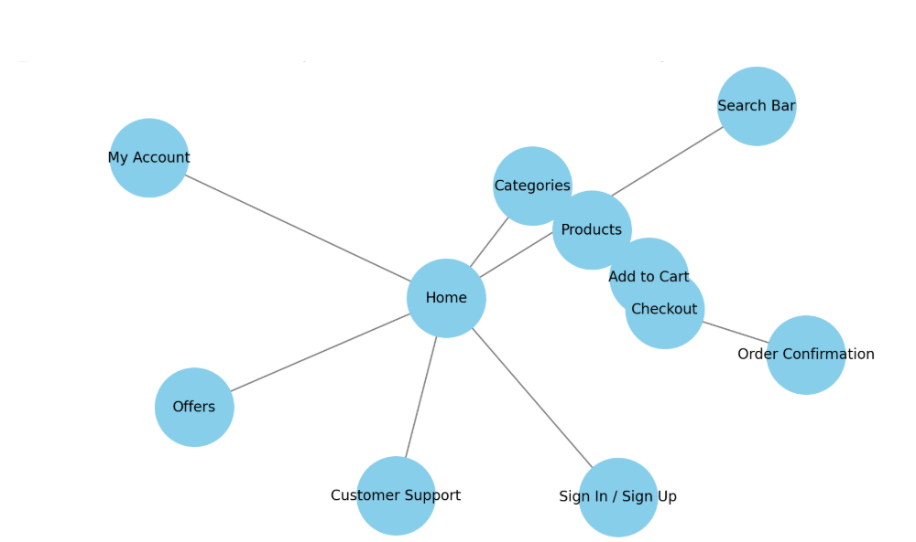
TASK 1 - CREATE A WEBSITE STRUCTURE

Slide 7
TASK 2 - TOPIC IDEAS
1. Groceries
Fresh Fruits and Vegetables
Dairy Products
Snacks & Beverages
Packaged Foods
Health & Wellness
2. Home Essentials
Household Cleaners
Kitchen Tools
Toiletries
Paper Products
4. Health and Wellness
Vitamins & Supplements
Fitness Equipment
Organic & Natural Products
3. Electronics & Gadgets
Mobilesories
Small Appliances
Headphones & Earbuds

Slide 8
TASK 3 - PICKING UP THE PAGES
Now, come up with an idea for your website’s https://docs.google.com/spreadsheets/d/1u3zbmBs-y9jJtpebgCv0ptNFM3GkCkwFM7_TjbUVH8g/edit?usp=sharing

Slide 9
TASK 4 - CONTENT STRUCTURE
Top Ranking Keywords | Volume | Position
chips | 110,000 | 1
ice cream | 550,000 | 5
Chocolate | 420,000 | 4

Slide 10
TASK 5 - COMPETITIVE ANALYSIS
COMPETITIVE ANALYSIS
Title - Blinkit - Quick Commerce | 10-Minute Grocery Delivery
Meta description - Blinkit offers 10-minute grocery delivery services across India. Shop fresh groceries, fruits, vegetables, and more from the comfort of your home. Available in 30+ cities.
Content and Keywords – Primary Keywords: Quick commerce, Grocery delivery in India, Online grocery shopping
Secondary Keywords: Fresh fruits and vegetables delivery, 10-minute delivery services
High-quality Content - Include an FAQ section addressing user queries such as, “How does Blinkit deliver in 10 minutes?
Headers – H1,2,3,4,5,6 - H1 & H2 are the most important, with only one h1 and other headers according to content.
Call to Action (CTA) - Order Now, Explore Our Product Range
Sitemap - create a sitemap accordingly priority
Interlinking & Anchor tax - Use descriptive anchor text like “Blinkit’s quick delivery services” instead of generic terms like “click here.”
Mobile responsiveness – Prioritize mobile optimization, as the majority of users order through smartphones.
Website Speed - Should be able to load quickly both on the web and mobile. The ideal speed is under 2-3 seconds
ibility points

Slide 11
TASK 6 - KEYWORD RESEARCH
Tools for Research
Google Keyword Planner
Ahrefs / SEMrush
Uber suggest
Answer the Public
GoogleTrends
Brand Keywords
Blinkit
Blinkit grocery delivery
Blinkit 10-minute delivery
Blinkit online shopping
Grofers to Blinkit transition
Product-Specific Keywords
Fresh fruits and vegetables online
Grocery delivery services in India
Online meat delivery
Buy snacks online
Location-Based Keywords
Grocery delivery in [city name]
Quick grocery delivery near me
Online grocery stores in [city name]
Competitor Keywords
Zepto grocery delivery
Swiggy Instamart
BigBasket vs Blinkit
Quick delivery apps in India
Long-Tail Keywords
Best grocery delivery apps in India
How does Blinkit deliver in 10 minutes?
Is Blinkit cheaper than BigBasket?
Can I order groceries late at night?
Top quick-commerce services in India

Slide 12
TASK 7 - ON-PAGE ELEMENTS
ON-PAGE ELEMENTS
Title - Blinkit - Quick Commerce | 10-Minute Grocery Delivery
Meta description - Blinkit offers 10-minute grocery delivery services across India. Shop fresh groceries, fruits, vegetables, and more from the comfort of your home. Available in 30+ cities.
Content and Keywords – Primary Keywords: Quick commerce, Grocery delivery in India, Online grocery shopping
Secondary Keywords: Fresh fruits and vegetables delivery, 10-minute delivery services
High-quality Content - Include an FAQ section addressing user queries such as, “How does Blinkit deliver in 10 minutes?
Headers – H1,2,3,4,5,6 - H1 & H2 are the most important, with only one h1 and other headers according to content.
Call to Action (CTA) - Order Now, Explore Our Product Range
Sitemap - create a sitemap according to priority
Interlinking & Anchor tax - Use descriptive anchor text like “Blinkit’s quick delivery services” instead of generic terms like “click here.”
Mobile responsiveness – Prioritize mobile optimization, as the majority of users order through smartphones.
Website Speed - Should be able to load quickly on the web and mobile. The ideal speed is under 2-3 seconds
ability points

Slide 13
TASK 8 - EXAMPLE BLOG
Title: Blinkit: Revolutionizing Grocery Shopping with 10-Minute Delivery
Meta Description: Discover Blinkit’s 10-minute grocery delivery service that’s transforming convenience. Shop fresh produce, snacks, and essentials anytime, anywhere.
Experience Convenience Like Never Before
In today’s fast-paced world, convenience is no longer a luxury—it’s a necessity. Blinkit understands this perfectly, offering 10-minute grocery delivery that redefines online shopping. Whether you need fresh fruits, vegetables, or daily essentials, Blinkit ensures a seamless shopping experience.
Why Choose Blinkit?
1. Superfast Delivery
Forget long waits or crowded stores. Blinkit delivers groceries in just 10 minutes, saving you precious time.
2. Wide Product Range
From pantry staples to personal care items, Blinkit’s extensive catalog has everything you need, just a few taps away.
3. Easy-to-Use App
The Blinkit app is designed for simplicity. Browse categories, apply filters, and track your orders in real-time.
4. Affordable Pricing
Enjoy competitive prices and exclusive discounts, making quality groceries more accessible than ever.
What Customers Love About Blinkit
Blinkit has become a favorite among busy professionals and families alike. "I love the speed and convenience Blinkit offers! It’s a game-changer for my daily routine," says Priya, a satisfied customer from Delhi

Slide 14
CONCLUSION AND TAKEAWAYS
This project has been instrumental in deepening my understanding of the objectives and goals of an effective SEO strategy. Through analyzing Blinkit’s approach, I have gained insights into the importance of keyword optimization, on-page elements like meta descriptions and headers, and user-centric content that aligns with search intent.
Moving forward, I plan to leverage this knowledge in my digital marketing efforts. By focusing on strategic keyword research, creating high-quality content, and enhancing website structure, I aim to improve organic rankings and drive targeted traffic. Incorporating these SEO techniques will not only support my goals of increasing visibility but also ensure a stronger connection with the target audience. This comprehensive understanding of SEO will undoubtedly help in achieving long-term success in the dynamic field of digital marketing.

